Slide 1


CMS 1.9 Demo
for IMS
November 18, 2025
PRESENTED BY Nicholas Chambers
1

Slide 2


Agenda
Recap of CMS Releases
Summary of Changes in CMS 1.9
Active Directory for Users + Intranet
Roles & Permissions Manager
News Redesign
News Premium Add-On
Other Updates
Production Issue and Bug Fixes
What’s Next?
CMS 1.9 Demo for IMS | November 2025

Slide 3
Recap of CMS Releases
November 19, 2025
CMS 1.8
CMS 1.9
CMS 1.10
July 2025
January/February 2026 (Tentative)
Past Release
Future Release
CMS 1.9 Demo for IMS | November 2025

Slide 4
Summary of Changes in CMS 1.9
Active Directory User and Intranet Sync Now Available
News Design Properties Fixed and New Ones Added
News Tags, Views, Multiple RSS, and Subfolders Add-On
Backoffice UI Updates Across the CMS
Multiple Production Issue Resolutions
Faster Way of Locating Pages in Backoffice
CMS 1.9 Demo for IMS | November 2025

Slide 5
Active Directory Sync for Users + Intranet
CMS 1.9 is the first release to support active directory sync for CMS Backoffice users and intranet members.
Active directory sync will be managed using the new Roles & Permissions Manager module found at roles.govstack.com.
At this time, the Roles & Permissions Manager will only be used for clients where active directory sync is requested.
All other clients will continue to use the same user management systems available previously.
Clients with active directory sync enabled vs. regular clients have different implementation considerations.
Active directory sync has a new user management experience, and some limitations in the way permissions are set.
There are no changes to the way user management works for regular clients.
CMS 1.9 Demo for IMS | November 2025

Slide 6
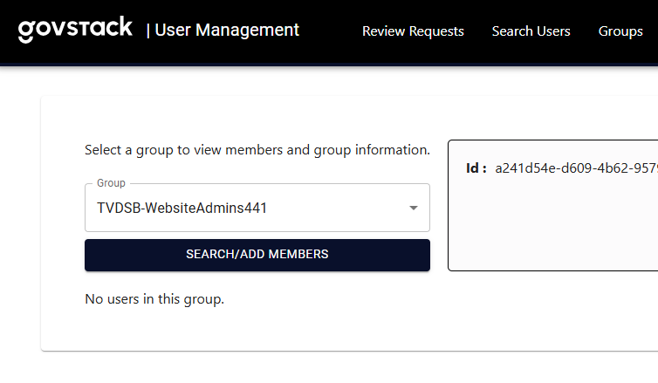
Roles & Permissions Manager – When to Use
When active directory sync is requested by a client, the Roles & Permissions Manager works together with the Admin Portal, as found at its new URL: accounts.govstack.com
We will configure user groups that pair with the client’s active directory groups, with the naming convention: [Client Name]-[Group Name]
When enabled, the Roles & Permissions Manager replaces the following CMS functions:
User group creation, and deletion
Assigning users to groups
Configuring group permissions toggles
Creating intranet members and groups
We can use Client Instance Switch to support clients with their users, intranet members, and permissions setups.
CMS 1.9 Demo for IMS | November 2025

Slide 7
Roles & Permissions Manager – What it Does
In the Admin Portal, users and AD groups are created, and then synced to the Roles & Permissions Manager.
Client administrators configure CMS role permissions of user groups or intranet member groups in the Roles & Permissions Manager.
Users, user groups, members, and members groups are pushed to CMS from the Roles & Permissions Manager.
Client administrators configure starting nodes and granular permissions of user groups in CMS Users section.
Intranet members are pushed into the Members section. In most cases no further configuration is needed for members after MCC setup.
Admin Portal: Create Users + User Groups
Roles & Permissions Manager: Configure Role Permissions
CMS: Users + Members + Groups Pushed
Users Section: Configure Start Nodes + Granular Permissions
Members Section: No Configuration Required
CMS 1.9 Demo for IMS | November 2025

Slide 8
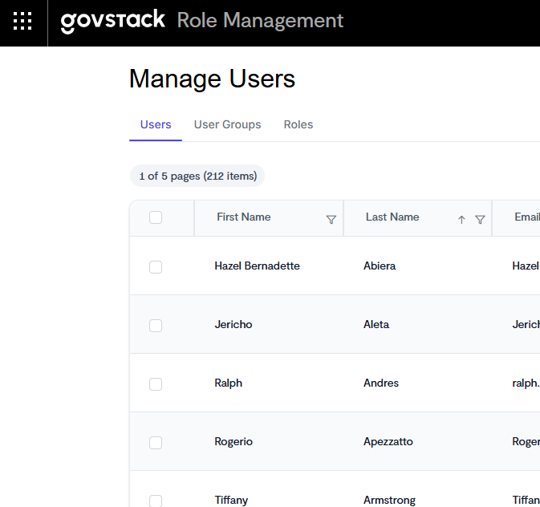
Roles & Permissions Manager – How to Use
Please note Roles & Permissions Manager is a first-generation product capable enough to handle clients with active directory sync needs, but is not complete.
When implementing clients:
Do check the Users and User Groups configurations if there are reported syncing issues or a mismatch from the Admin Portal.
Do attempt to sync users manually under the Users “Actions” menu to force a sync.
Don’t create or configure any Roles or their permissions, as this applies to every client.
Don’t configure the Platform Admin role permissions, as this can lock ourselves out.
CMS 1.9 Demo for IMS | November 2025

Slide 9

Demo: Roles & Permissions Module
9
CMS 1.9 Demo for IMS | November 2025

Slide 10
News Redesign
The CMS news feature received a significant overhaul, with over 300 new design properties – a 12 times increase over CMS 1.8.
The primary goals of this redesign were to fix a large number of properties in news that did not function, and to provide industry-leading design options for power-user clients.
Upon release, existing clients will be impacted in 2 ways:
If clients attempted to configure some properties in news that did not function, they may now begin to function, and the frontend appearance of their news pages will differ after release.
Clients that had “Show Line Divider” enabled for News Feed components will need to reconfigure it under the new “Item border style” property.
All news content will otherwise look the same way as it did in CMS 1.8 by default.
Please note: Some properties such as featured news labels use the “Label” colours in the Design node. This is the first time we are using these colours, which are currently empty for all clients. If a client raises a concern about empty properties, they should be informed that these options are exclusive to clients with Design node access, and it can be configure there.
CMS 1.9 Demo for IMS | November 2025

Slide 11
News Redesign – What Did We Add?
Featured news is back, and is now set per news feed or news listing page rather than the post itself.
We can now limit the posts that show on news listing pages either by category or by author.
News feeds and listings can now be done horizontally, with 1-8 posts per row.
News feeds can be chained together to achieve almost any layout.
Posts in the feed or listing can have:
5 text and image positions alike Pods
38 date formats
3 line divider styles between posts
Limit summary text length by number of characters
Category labels with their own colours and icon
Featured posts can be given a completely different design from regular posts within the same listing
Listings can now have individual filters enabled or disabled, and displayed as dropdowns or buttons.
Authors are now their own listing page, including the ability to set an author image that shows with posts.
CMS 1.9 Demo for IMS | November 2025

Slide 12
News Premium Add-On
CMS 1.9 extends the news feature further with a 4-in-1 add-on that includes the following parts:
Tags: This provides a way for clients to create extra levels of sorting news posts. For example, clients can indicate things like neighbourhoods, regions, transit routes, statuses, or subcategories.
Views: Currently clients only have one listing page with all news posts. Views lets clients create multiple listing pages with all the same design controls that they can use to give them their own look and feel.
Post Subfolders: This allows clients to organize their posts within subfolders, if they want to separate users from each other or give a set of posts their own appearance.
Multiple RSS Feeds: Currently clients only have one RSS feed for all their news posts. This option lets clients create additional RSS feeds that can be configured to pull specific posts as needed.
Final pricing is still to be determined but the add-on will be available in the near future.
For simplicity, we can refer to our complete news feature as using a C.A.T.S. system – Categories, Authors, Tags, and Style.
CMS 1.9 Demo for IMS | November 2025

Slide 13
Demo: News Redesign and News Premium
13
CMS 1.9 Demo for IMS | November 2025

Slide 14
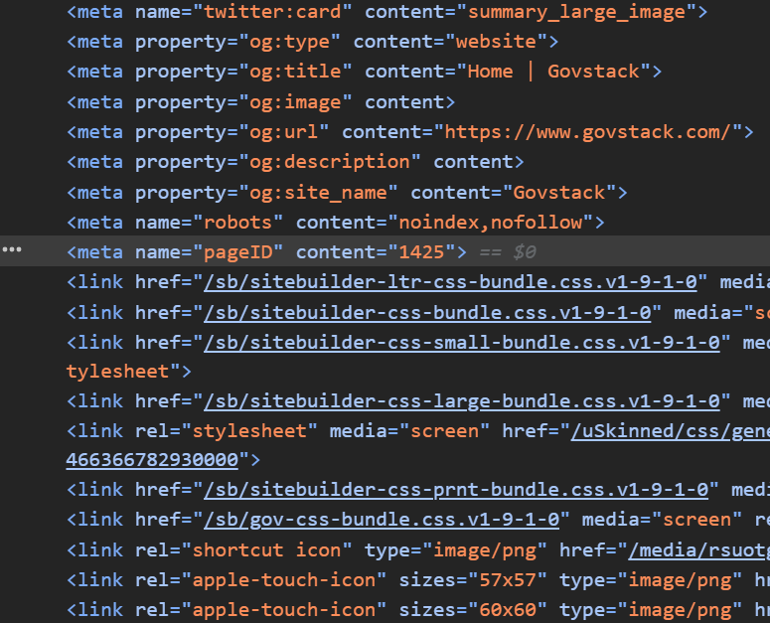
Find Pages Faster in the Backoffice
This CMS release added a new meta tag element on the frontend of all pages on the website called “pageID”.
This page ID can be used to find the page in the Backoffice by changing the URL, rather than having to hunt through the Content tree or search for the page manually.
For example, the homepage may have a “pageID” of 1425, which we can use to construct the Backoffice URL of the page, which looks like:
https://www.govstack.com/umbraco#/content/content/edit/1425?mculture=en-US
CMS 1.9 Demo for IMS | November 2025

Slide 15
Other Updates
Many Backoffice UI improvements have been implemented to make content easier to find and work with. Most content tree items have new icons and colours, and most components use a larger editor overlay.
Many properties have been renamed with better labels and descriptions to improve their clarity.
The “Outbound Link” item has been renamed to “Menu Link” and can now be hidden from the site’s navigation and default built-in Govstack site search.
The “Culture and Hostnames” action has been removed for clients to avoid clients breaking their site.
Listings of Media and Members now show more information at-a-glance. For example, Media tables now show the file type, file size, and alternative text of items. Members lists now show 100 items instead of 10, and indicates whether a member is approved and the last time they logged in.
Global nodes (a.k.a “Subsites”) can now be applied to more places in the CMS, such as Media Manager pages, News Posts, Business Directories, Parks & Facilities listings, and Parser pages.
Images in the Business Directory and Parks & Facilities pages now have configurable sizes, and no longer require exact dimensions on upload.
CMS 1.9 Demo for IMS | November 2025

Slide 16
Production Issue and Bug Fixes
All remaining unsupported properties have been removed, such as the “Shop” tab in the Global node.
News post subscriber notifications now fall back to the name of the post for the ##HEADING## token rather than requiring the Summary “Heading” to be filled out.
The “Subscription Messaging” email template social media icons are no longer broken images in the email.
Image sizing and stretching issues with Text/Image overlays and Banners components has been fixed.
The Text/Icon component’s different icon positions now reflect the chosen icon size correctly, functions with raster images such as PNGs and JPGs, and can now be used in the footer.
Fixed an issue with Calendar Feed images colliding with event details on mobile.
The Calendar Feed component now shows ampersands correctly in the feed.
The News Feed ticker now displays correctly and can be used in more areas of the site, like the footer.
CMS 1.9 Demo for IMS | November 2025

Slide 17
Production Issue and Bug Fixes (1)
Reusable Components no longer add unexpected spacing compared to regular components.
Fixed an issue where light window titles didn’t support quotation marks.
The Business Directory and Parks & Facilities “Get Directions” link now uses the complete address.
Multiple minor frontend presentation fixes to Business Directory and Parks & Facilities pages.
Menu Manager “Multi-Level Menus” no longer encounter 500 errors with unpublished or deleted pages.
Cludo autocomplete results are no longer hidden behind other content on the page, and Cludo search results are now responsive on mobile.
Outbound Links/Menu Links now route to the intended page when they appear in the Govstack built-in site search results.
CMS 1.9 Demo for IMS | November 2025

Slide 18
Production Issue and Bug Fixes (2)
Redirects can now be used with services that add randomized query strings or tracking parameters to the URL. Alternative URLs no longer need to be created as a workaround.
Dropdown menu question types placed at the bottom of a form in Govstack Forms no longer get cut off.
7 client-reported accessibility issues have been resolved.
The Govstack site credit in the footer has been updated to avoid a 308 redirect that was occurring.
We’ve attempted a fix to reduce memory usage to prevent sites from encountering 500 errors.
CMS 1.9 Demo for IMS | November 2025

Slide 19
What’s Next
Subscription 1.1
Platform 1.6
CMS 1.10
Subscription lists per Home node
Time zone presentation fixes
Admin Portal URL change
Ribbon URL updates
CMS, Events, Forms client switch
Missing dashboard tile fixes
New Govstack branding
Zendesk chatbot
WalkMe notifications
30+ Production issue fixes
More Content. More Power.
CMS 1.9 Demo for IMS | November 2025

Slide 20
Thank you
ghd.com/digital

Slide 21
Resources
CMS 1.9 Release Notes:
https://ghddigital.atlassian.net/wiki/spaces/GOV/pages/4113727517/Govstack+CMS+1.9.0+and+1.9.1+Release
CMS 1.9 Release Tickets:
Group 1 (Non-Live Clients): https://ghddigital.atlassian.net/browse/RELEASE-11980
Group 2 (Live Clients Group 1): https://ghddigital.atlassian.net/browse/RELEASE-11981
Group 3 (Live Clients Group 2): https://ghddigital.atlassian.net/browse/RELEASE-12079
Group 4 (Live Clients Group 3): https://ghddigital.atlassian.net/browse/RELEASE-12080
CMS 1.9 Demo for IMS | November 2025

